Slide 1







organizes
Dates: 23 – 24 February 2024
Paper Title
Author 1 Name Affiliation
Author 2 Name Affiliation
Author 3 Name Affiliation
Author 4 Name Affiliation

Slide 2

Contents
Abstract
Introduction
Literature Survey
Problem Definition
Proposed Work
Methodology & Implementation
Results & Discussions
Conclusion
Reference

Slide 3
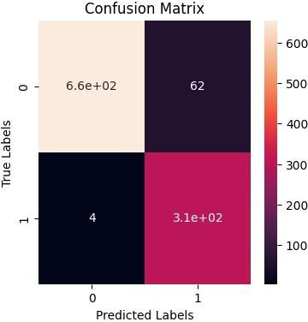
Abstract
Fire accidents are serious, causing economic loss, endangering lives, and harming natural resources.
Deep learning, like the CNN-LSTM hybrid model, helps detect fires in diverse settings, from forests to commercial spaces.
Combining architectures like MobileNetV2 and Xception improves fire detection accuracy, with an ensemble achieving 94% accuracy in experiments.

Slide 4
Introduction
Fire, both friend and foe throughout human history, poses significant threats, ranging from property damage to health concerns and economic strain.
Traditional fire detection and suppression technologies, while valuable, have limitations that AI-enabled surveillance technologies aim to overcome.
AI-enabled surveillance systems, leveraging advanced algorithms and data analysis, offer flexible, effective, and comprehensive approaches to fire detection and security.
Cutting-edge AI models like the hybrid CNN-LSTM and combined Xception and MobileNetV2 architectures show promise in enhancing fire detection accuracy and efficacy, potentially advancing fire detection technologies significantly.

Slide 5
Literature Survey
Researchers use diverse datasets and advanced deep learning methods, including transfer learning, to improve fire detection accuracy.
Deeper CNN models like VGG16 and ResNet50, with optimized fully connected layers, excel at detecting fires even in challenging, imbalanced datasets.
New deep learning systems such as Fire Net and DTA tackle fire detection challenges like imbalanced data and dynamic fire behavior with unique architectures.
Emerging technologies like Vision Transformers (ViT) provide innovative solutions for fire monitoring, offering high accuracy and early detection capabilities in security video systems.

Slide 6
Problem Definition
Despite advancements in fire detection technologies, current methods such as heat sensors and smoke detectors have limitations in accurately detecting fires in diverse environments. These limitations include susceptibility to false alarms, inefficiency in detecting low-smoke or slow-burning fires, and challenges in outdoor or highly humid areas. Additionally, traditional methods may struggle with detecting fires in the early stages or in situations involving flammable substances or electrical equipment. Furthermore, the computational intensity and requirement for large datasets in training deep learning models for fire detection pose challenges.

Slide 7
Proposed Work
This study proposes the development and evaluation of deep learning models for fire detection. Specifically, the study focuses on implementing a hybrid CNN-LSTM model, which combines Convolutional Neural Networks (CNNs) for spatial feature extraction and Long Short-Term Memory (LSTM) networks for temporal sequence analysis. Additionally, an ensemble approach using transfer learning models such as Xception and MobileNetV2 is explored to improve classification accuracy. By leveraging these advanced techniques, the aim is to enhance the accuracy and efficiency of fire detection systems across various environments, including forests, commercial kitchens, and indoor spaces.

Slide 8
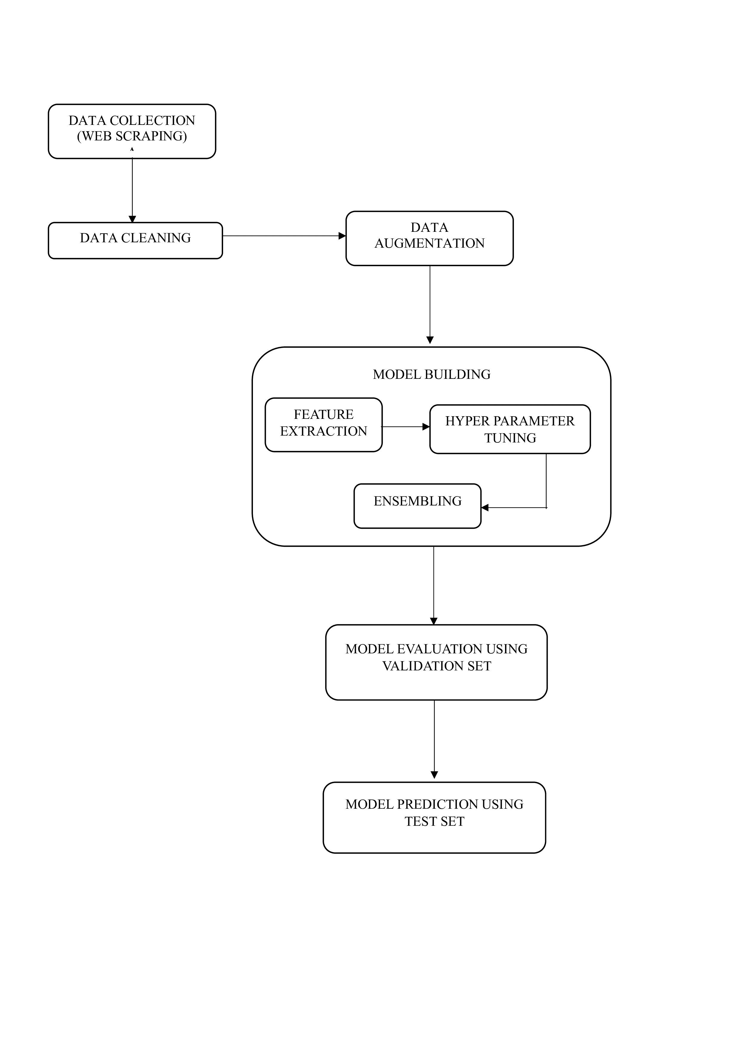
Methodology & Implementation
The CNN-LSTM hybrid model combines CNNs and LSTMs, leveraging CNNs' spatial understanding and LSTMs' temporal context to enhance fire detection accuracy by reducing false alarms.
Combining Xception and MobileNetV2 models into an ensemble improves classification accuracy by addressing individual model weaknesses, demonstrating the value of ensemble techniques in enhancing overall system performance.
While the ensemble model shows promise, understanding the limitations of individual models and the need for post-processing techniques is crucial for real-world applications. Continued research into stronger models and hybrid strategies is recommended for advancing fire detection technology.

Slide 9
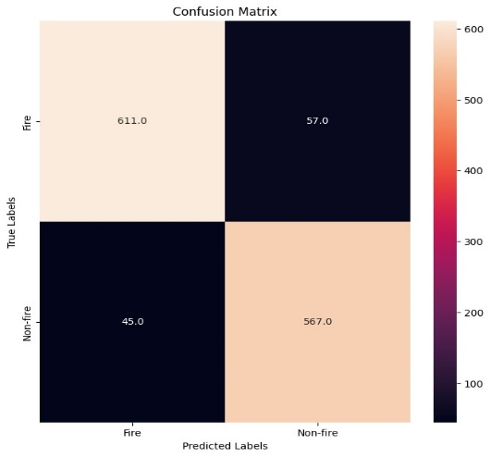
Results & Discussions
The CNN-LSTM hybrid model achieved an accuracy of 87%, with a precision, recall, and F1-score of 0.87, 0.88, and 0.88 respectively. It exhibited a slightly higher Type II error (missing fire detection), indicating potential improvement opportunities.
The ensemble model of Xception and MobileNetV2 achieved a superior accuracy of 92%, with higher precision, recall, and F1-score of 0.93, 0.91, and 0.92 respectively. It showed fewer Type II errors, making it more reliable for fire detection tasks.

Slide 10
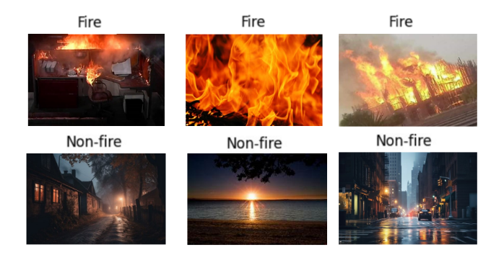
Conclusion
Our study presents successful models for fire detection, including a CNN-LSTM hybrid model and an ensemble of deep learning models like Xception and MobileNetV2. The CNN-LSTM hybrid model achieved an impressive accuracy rate of 92%, surpassing current state-of-the-art methods.
Experimentation with an ensemble of Xception, ResNet50, and Inception models further improved accuracy to 94%, showcasing the potential of combining different models for enhanced performance in fire detection tasks.

Slide 11
Reference
https://fireecology.springeropen.com/articles/10.1186/s42408-022-00165-0
https://link.springer.com/chapter/10.1007/978-3-319-65172-9_16
https://www.proquest.com/openview/d182bebd88844fb5d0eb568efcf325c8/1?pq-origsite=gscholar&cbl=2049588
https://www.hindawi.com/journals/js/2022/8044390/
https://www.mdpi.com/1999-4907/12/2/217
https://ieeexplore.ieee.org/abstract/document/9584840
https://link.springer.com/chapter/10.1007/978-3-031-06794-5_4
https://link.springer.com/article/10.1186/s42408-023-00216-0
https://www.sciencedirect.com/science/article/abs/pii/S092427162100160X
https://ijisae.org/index.php/IJISAE/article/view/1455
https://www.mdpi.com/1424-8220/23/3/1512
https://www.sciencedirect.com/science/article/pii/S2214157X2030085X

Slide 12
Thank You

